Slide 1

Topic 2
K-means algorithm implemented
from the scratch in Matlab
2022.04.25 / Jueun Park (PAR0161)

Slide 2

What is k-means algorithm
Implement k-means algorithm
Working for 1D data
Working for 2D data
Working for 3D data
01
02
03
04
05

Slide 3
What is k-means algorithm?
CHPATER 01
PAR0161
The k-means clustering algorithm is an algorithm that combines a given data into k clusters, and operates in a way that minimizes the variance of distance differences with each cluster. This algorithm is a kind of autonomous learning, which serves to label unlabeled input data.

Slide 4
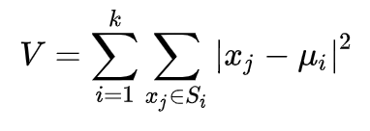
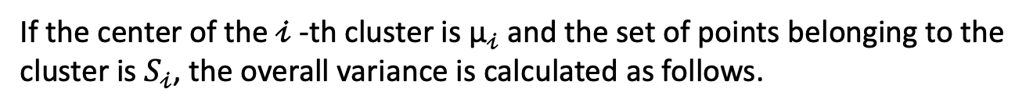
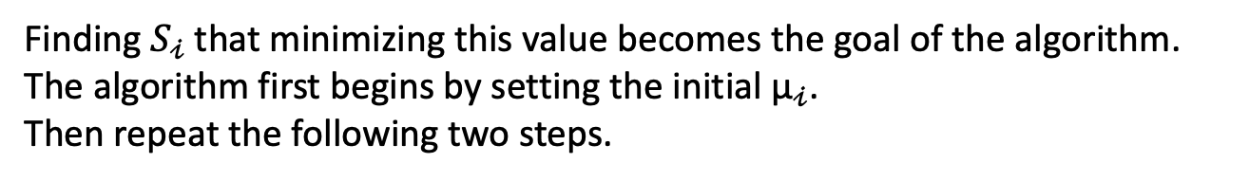
What is k-means algorithm?
CHPATER 01
PAR0161
If the center of the $𝒾$-th cluster is ${\text{µ}}_{𝒾}$ and the set of points belonging to the cluster is $S_{𝒾}$, the overall variance is calculated as follows.
Finding $S_{𝒾}$ that minimizing this value becomes the goal of the algorithm.
The algorithm first begins by setting the initial ${\text{µ}}_{𝒾}$.
Then repeat the following two steps.

Slide 5
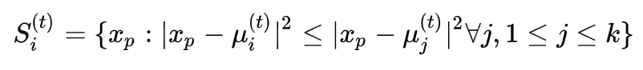
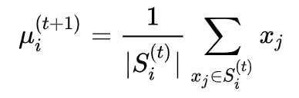
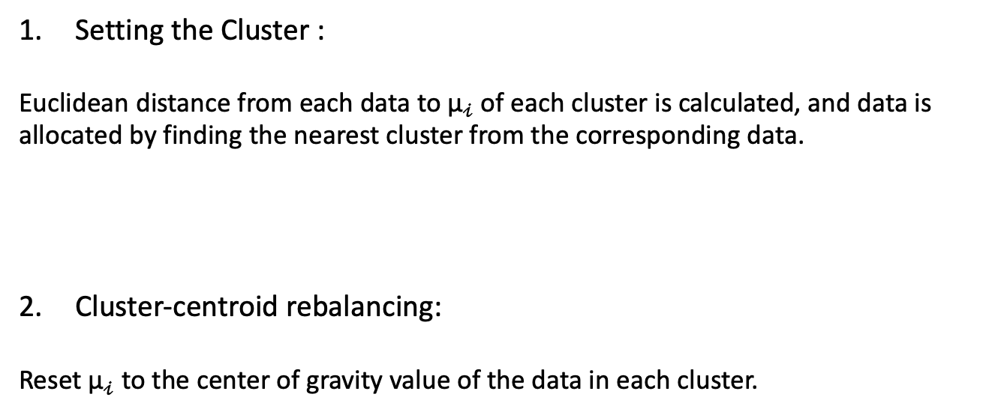
What is k-means algorithm?
CHPATER 01
PAR0161
Setting the Cluster :
Euclidean distance from each data to ${\text{µ}}_{𝒾}$ of each cluster is calculated, and data is allocated by finding the nearest cluster from the corresponding data.
Cluster-centroid rebalancing:
Reset ${\text{µ}}_{𝒾}$ to the center of gravity value of the data in each cluster.
If the cluster does not change, stop repeating.

Slide 6
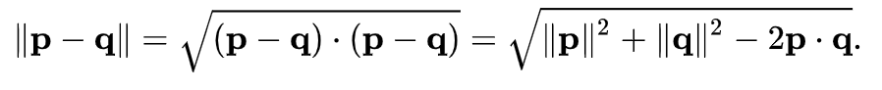
What is k-means algorithm?
CHPATER 01
PAR0161
Euclidean distance
Euclidean distance is a common method of calculating the distance between two points. This distance can be used to define the Euclidean space, and the norm corresponding to this distance is called the Euclidean norm.
When points p = (p1, p2,..., pn) and q = (q1, q2,..., qn) represented by an orthogonal coordinate system, the distance between two points p, q is calculated using two Euclidean norms.

Slide 7
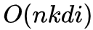
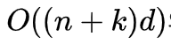
What is k-means algorithm?
CHPATER 01
PAR0161
Complexity
Two factors that greatly affect the computational complexity of the k-mean algorithm are Euclidean space d and the number of clusters k.
Even if the number of clusters is small, it is NP-hard to find the optimal solution of the k-means algorithm in the general Euclidean space d. Conversely, even in a low-dimensional Euclidean space, finding the optimal solution for k clusters is also NP-hard.
(*NP = Non-deterministic Polynomial time)
The time complexity is proportional to the number of clusters, the dimension of the data vector, and the number of data vectors, respectively. In addition, since the algorithm repeats until the solution converges, the algorithm is proportional to the number of iterations. That is, the time taken to group n d-dimensional data vectors into k clusters through i-times of repetition is
For space complexity, the algorithm must store additional information about the center of gravity vectors of each cluster, and since these center of gravity vectors are independent every iteration, the k-means algorithm has a space complexity of

Slide 8
What is k-means algorithm?
CHPATER 01
PAR0161
Limitation
The value of the number of clusters k should be specified as an input parameter.
There is a possibility that the error convergence of the algorithm will converge to a local minimum rather than a global minimum.
It is sensitive to outliers.
It is not suitable for finding clusters that are not spherical.

Slide 9

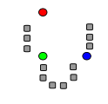
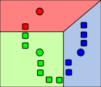
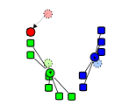
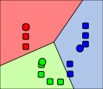
Implement k-means algorithm
CHPATER 02
PAR0161
The execution process of a standard algorithm
The initial k "average value"
(k=3 in this case) is randomly selected
from the data objects. (shown in colored circles).
2) Each data object is grouped
based on the nearest average value.
3) The average value is readjusted
based on the center point of k clusters.
4) Repeat steps 2) and 3) until convergence.

Slide 10
Implement k-means algorithm
CHPATER 02
PAR0161
Main Idea
Input
k: Number of Clusters
D: A set containing n data objects
Output
K clusters
Algorithm
From the data object set D, k data objects are randomly extracted, and these data objects are set to the center of each cluster. (Set initial value)
For each data object in the set D, obtain the distance from each of the k cluster-centered objects, and find which center is most similar each data object. Then, each data object is assigned to the center point found in that way.
Recalculate the center point of the cluster. That is, the center point is recalculated based on the reallocated clusters in (2).
Steps 2 and 3 are repeated until the cluster belonging to each data object is not changed.

Slide 11
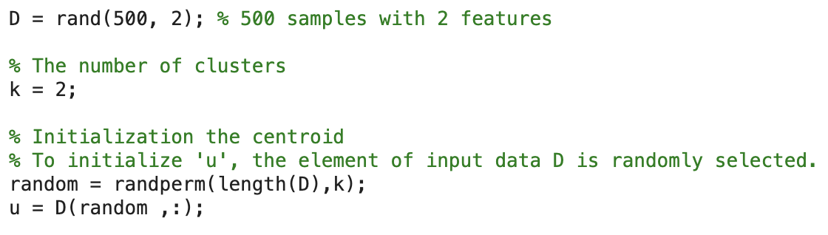
Implement k-means algorithm
CHPATER 02
PAR0161
Code
Two-dimensional spatial data, one of the most basic cluster data, is used as an example. K-Means algorithm initialization step. Optionally, select an element of input data D to initialize uk.
*Random Partition
After each data is allocated to an arbitrary cluster, the average value of the points allocated to each cluster is set to the initial u.

Slide 12
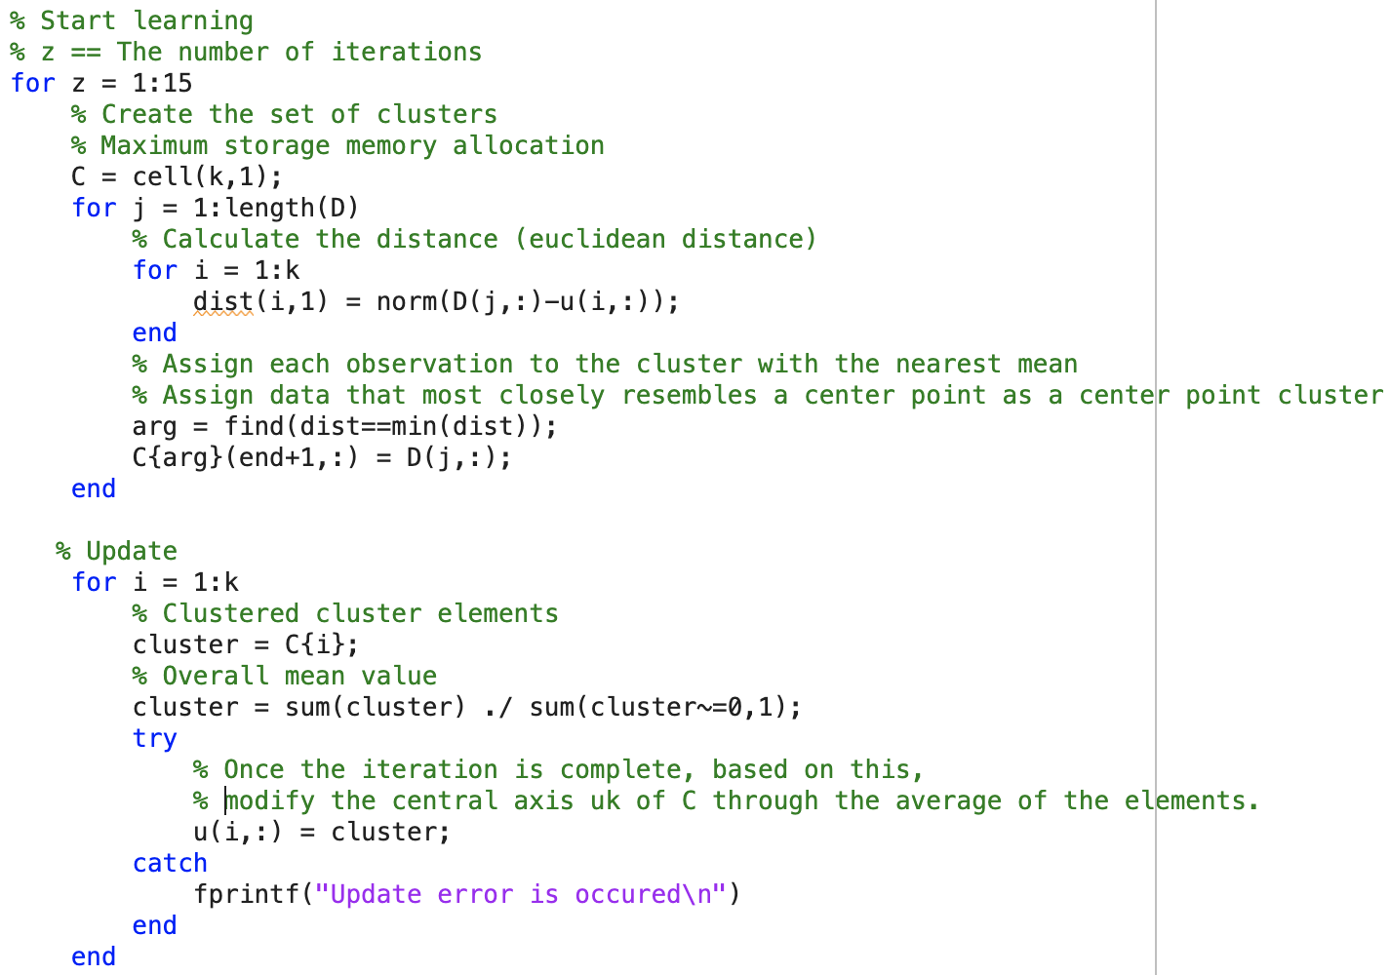
Implement k-means algorithm
CHPATER 02
PAR0161
Code
Initialize the cluster set C so that it can be updated every time the learning is repeated.
Then, scan all the data D to find the distance from Ck, and set it as an element of the set C with the nearest Centroid value.
Once repeated, the center axis uk of C is modified through the average of the elements based on .

Slide 13
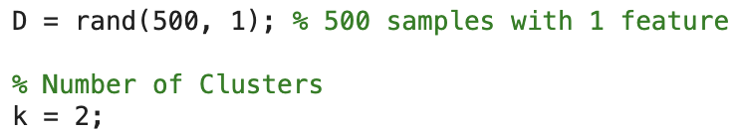
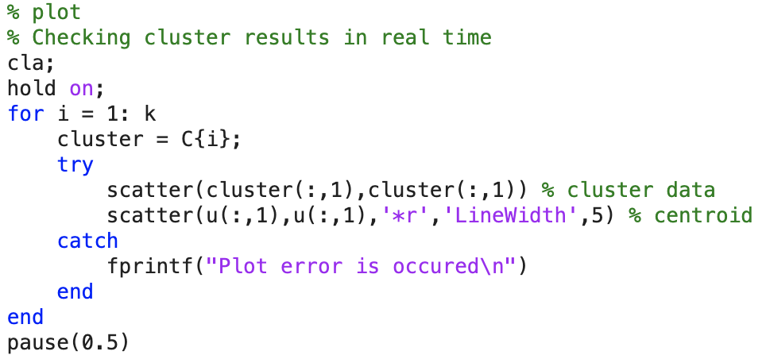
Working for 1D data
CHPATER 03
PAR0161
[setting]
[plot code]

Slide 14
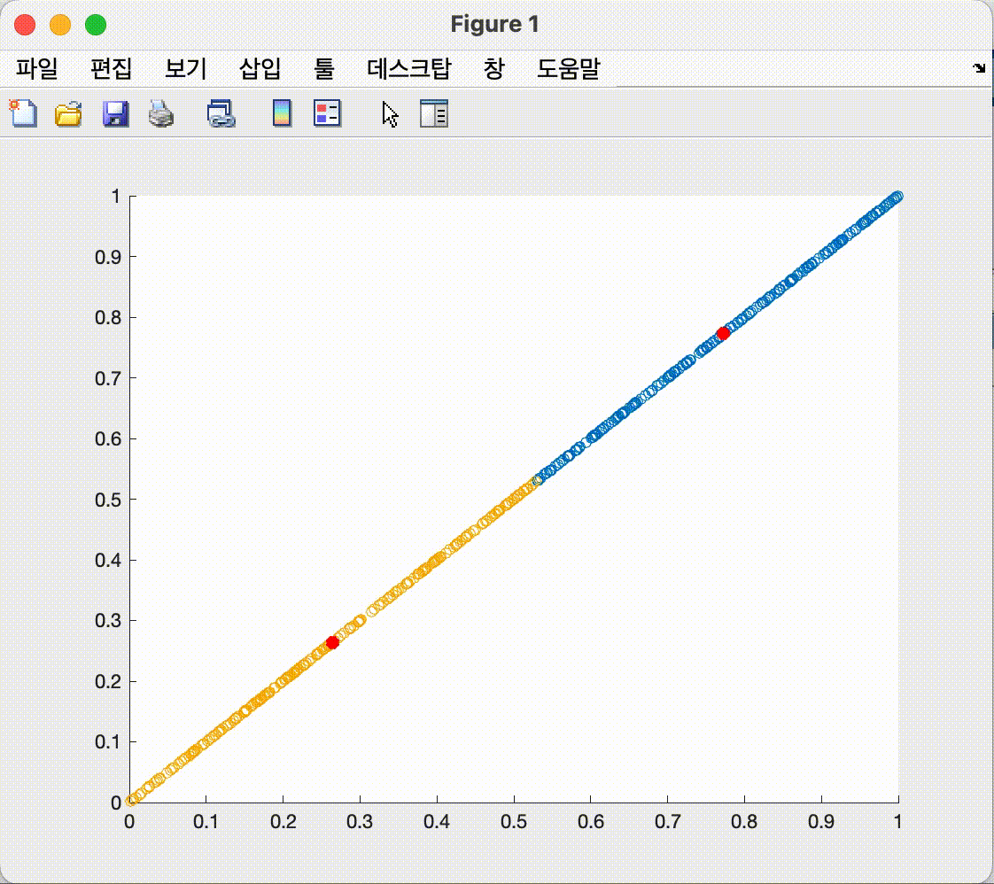
Working for 1D data
CHPATER 03
PAR0161
[result]

Slide 15
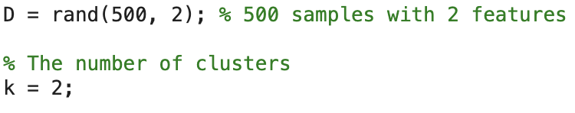
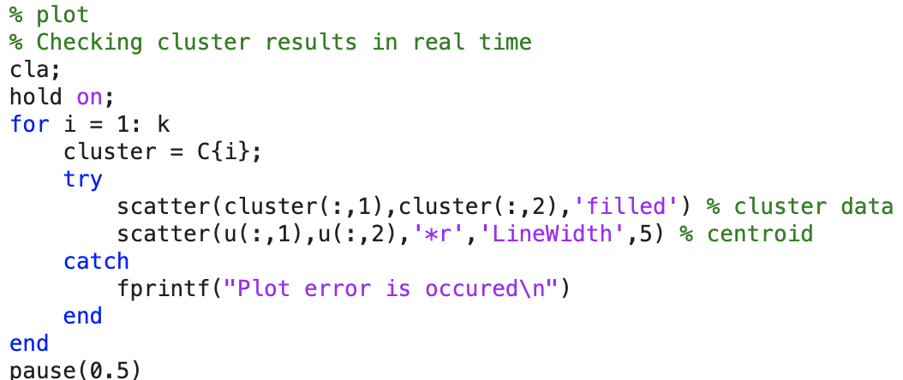
Working for 2D data
CHPATER 04
PAR0161
[setting]
[plot code]

Slide 16
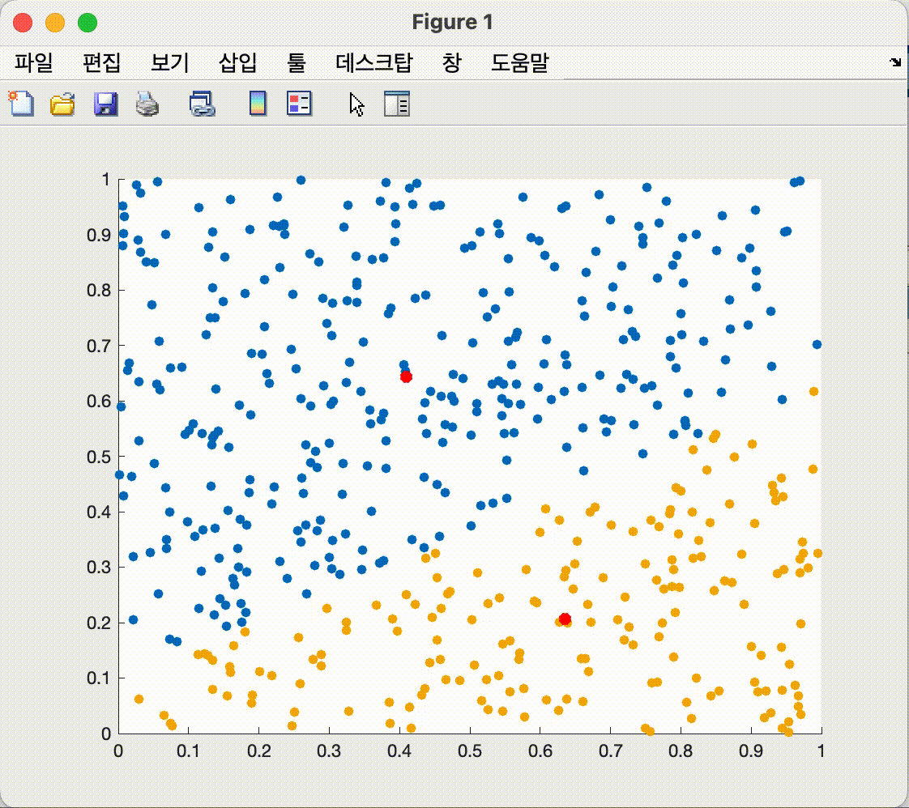
Working for 2D data
CHPATER 04
PAR0161
[result]

Slide 17
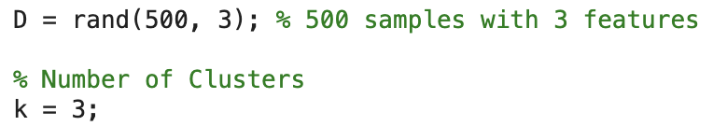
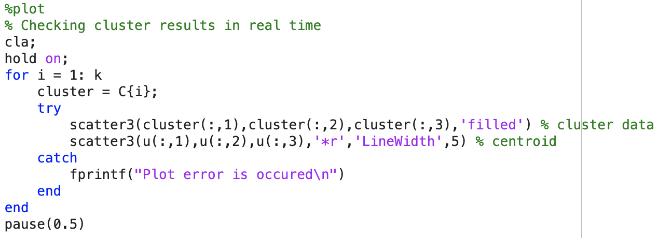
Working for 3D data
CHPATER 05
PAR0161
[setting]
[plot code]

Slide 18
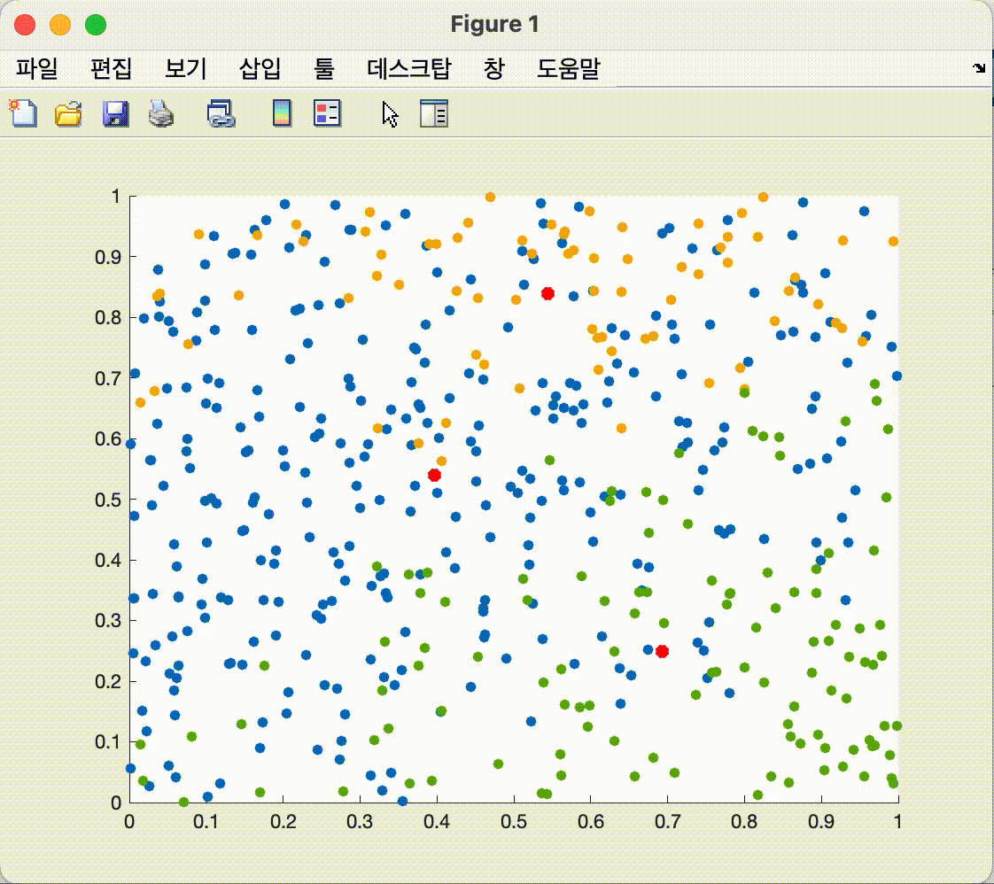
Working for 3D data
CHPATER 05
PAR0161
[result]

Slide 19


Slide 20

Thank you

